Slide 1

Random variable and probability distributions
MD. SHAHIDUL SALIM
LECTURER, CSE, KUET

Slide 2
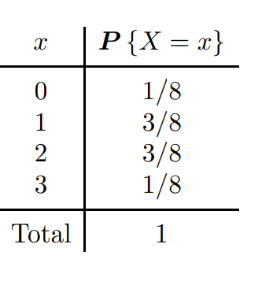
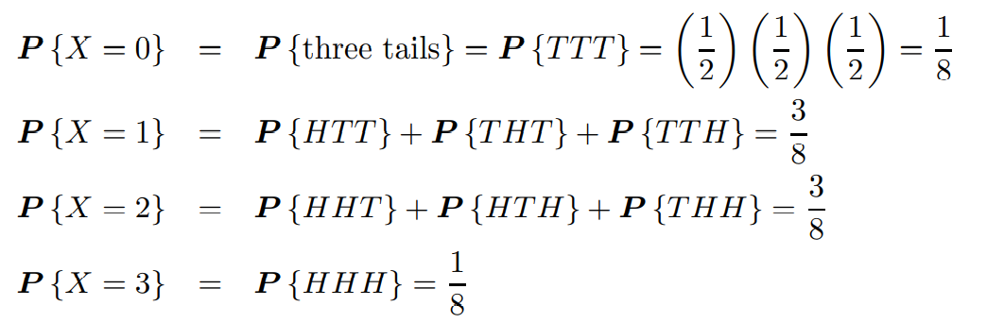
Random variable
Consider an experiment of tossing 3 fair coins and counting the number of heads.
Let X be the number of heads (girls, 1’s). Prior to an experiment, its value is not known. All we can say is that X has to be an integer between 0 and 3.

Slide 3
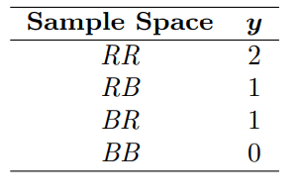
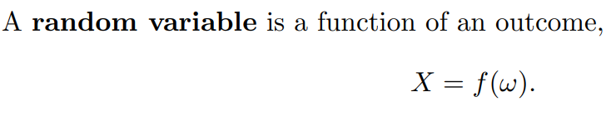
Random variable
Two balls are drawn in succession without replacement from an urn containing 4 red balls and 3 black balls. The possible outcomes and the values y of the random variable Y , where Y is the number of red balls, are
A random variable is a function that associates a real number with each element in the sample space.

Slide 4
Suppose a sampling plan involves sampling items from a process until a defective is observed. The evaluation of the process will depend on how many consecutive items are observed. In that regard, let X be a random variable defined by the number of items observed before a defective is found. With N a non defective and D a defective, sample spaces are S = {D} given X = 1, S = {ND} given X = 2, S = {NND} given X = 3, and so on.
A random variable is called a discrete random variable if its set of possible outcomes is countable.
When a random variable can take on values on a continuous scale, it is called a continuous random variable

Slide 5
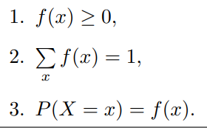
Discrete probability distributions
We write f(x) = P(X = x); that is, f(3) = P(X = 3).
The set of ordered pairs (x, f(x)) is a probability function, probability mass function, or probability distribution of the discrete random variable X if, for each possible outcome x,

Slide 6
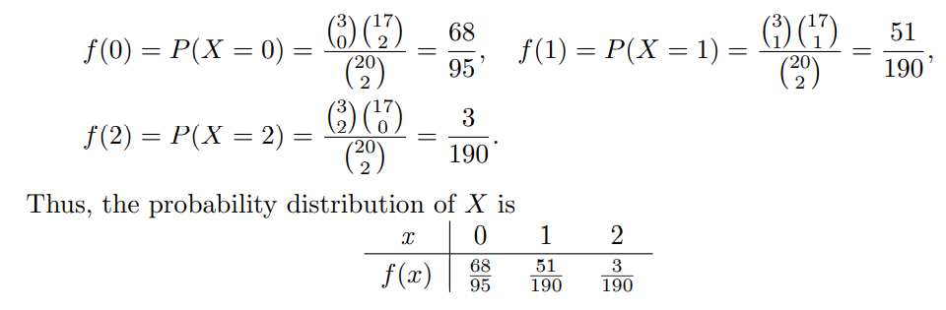
A shipment of 20 similar laptop computers to a retail outlet contains 3 that are defective. If a school makes a random purchase of 2 of these computers, find the probability distribution for the number of defectives.

Slide 7
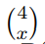
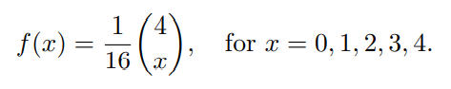
Example 3.9
If a car agency sells 50% of its inventory of a certain foreign car equipped with side airbags, find a formula for the probability distribution of the number of cars with side airbags among the next 4 cars sold by the agency.
Since the probability of selling an automobile with side airbags is 0.5, the 2⁴ = 16 points in the sample space are equally likely to occur.
In general, the event of selling x models with side airbags and 4 − x models without side airbags can occur in where x can be 0, 1, 2, 3, or 4.
Thus, the probability distribution f(x) = P(X = x) is

Slide 8
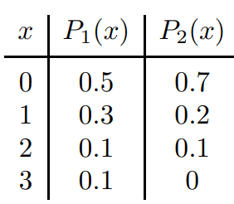
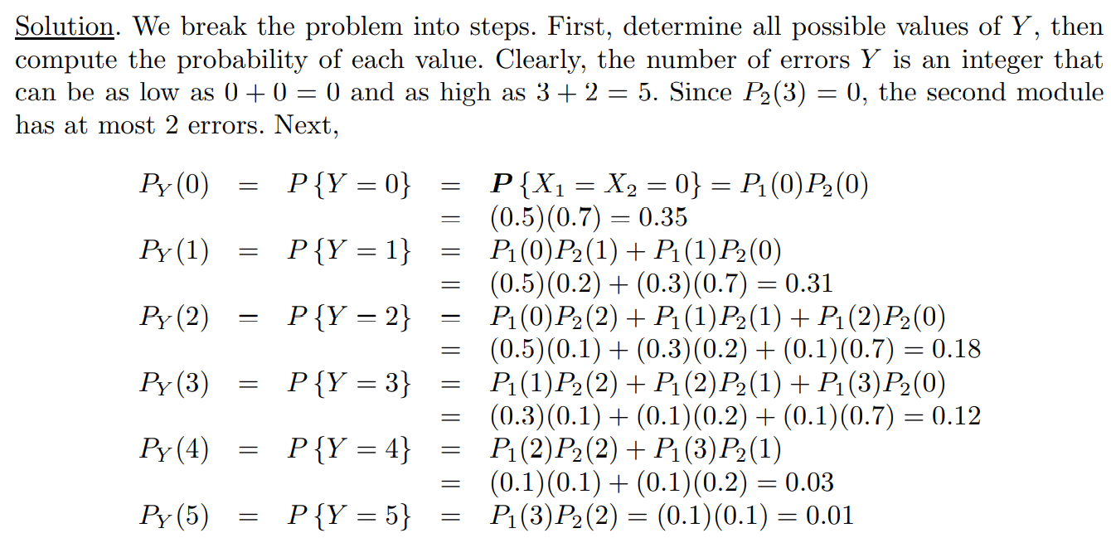
(Errors in independent modules). A program consists of two modules. The number of errors X₁ in the first module has the pmf P₁(x), and the number of errors X₂ in the second module has the pmf P₂(x), independently of X₁, where

Slide 9
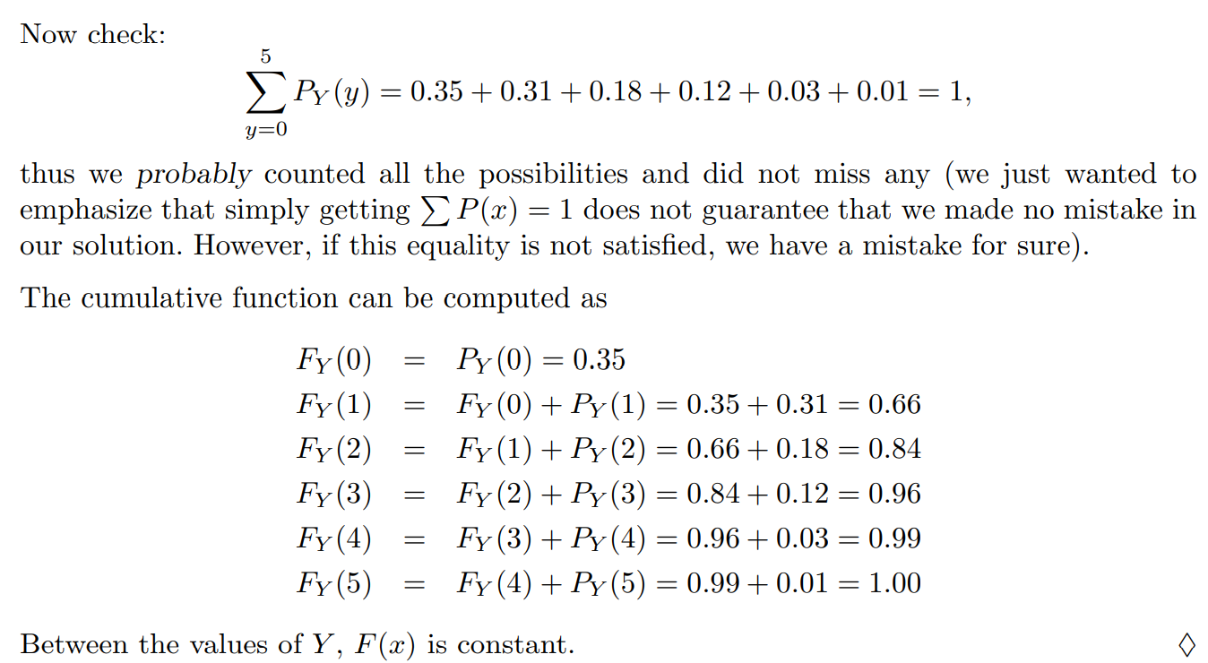

Slide 10
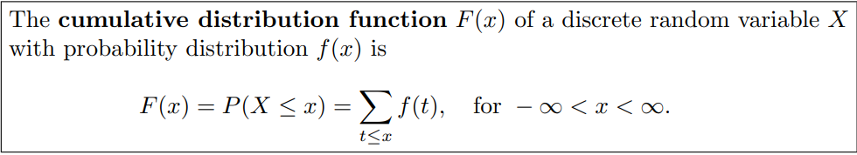
Cumulative distribution function
There are many problems where we may wish to compute the probability that the observed value of a random variable X will be less than or equal to some real number x.
Writing F(x) = P(X ≤ x) for every real number x, we define F(x) to be the cumulative distribution function of the random variable X.

Slide 11
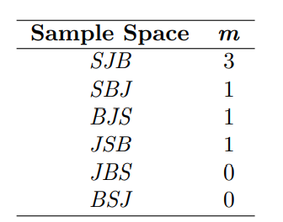
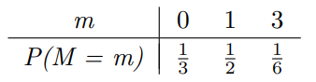
A stockroom clerk returns three safety helmets at random to three steel mill employees who had previously checked them. If Smith, Jones, and Brown, in that order, receive one of the three hats, list the sample points for the possible orders of returning the helmets, and find the value m of the random variable M that represents the number of correct matches.

Slide 12
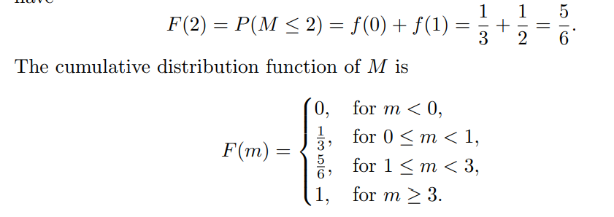
Nondecreasing function

Slide 13
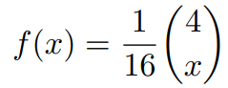
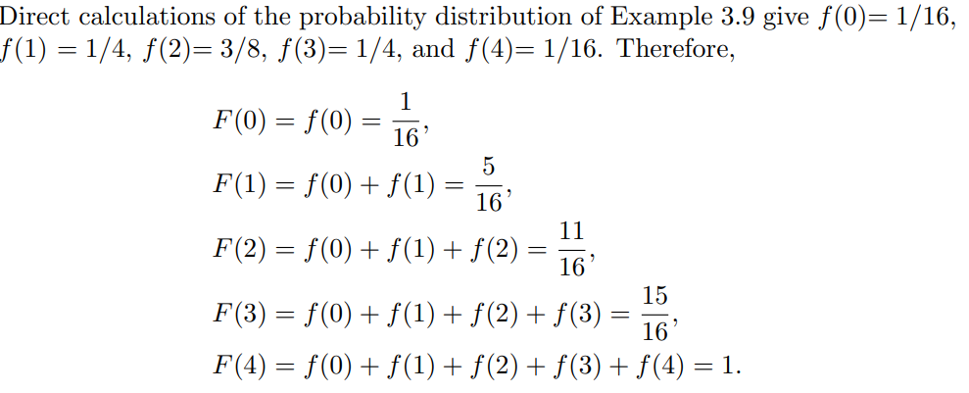
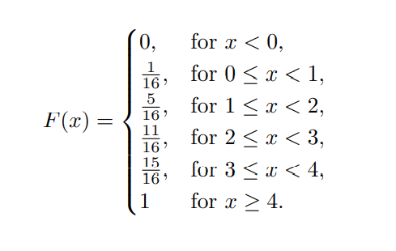
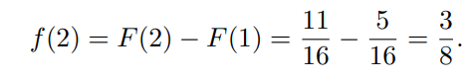

Slide 14
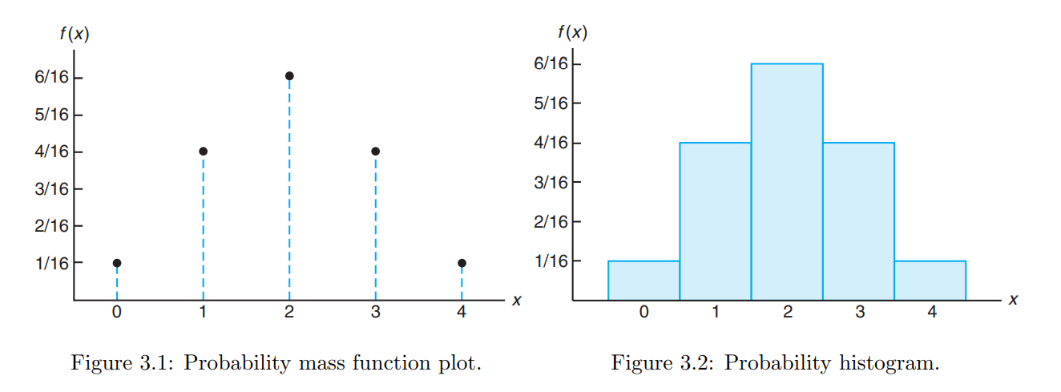
Probability histogram

Slide 15
Continuous probability distributions
Let us discuss a random variable whose values are the heights of all people over 21 years of age. Between any two values, say 163.5 and 164.5 centimeters, or even 163.99 and 164.01 centimeters, there are an infinite number of heights, one of which is 164 centimeters. The probability of selecting a person at random who is exactly 164 centimeters tall and not one of the infinitely large set of heights so close to 164 centimeters that you cannot humanly measure the difference is remote, and thus we assign a probability of 0 to the event. This is not the case, however, if we talk about the probability of selecting a person who is at least 163 centimeters but not more than 165 centimeters tall.

Slide 16
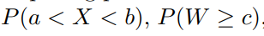
PDF
We shall concern ourselves with computing probabilities for various intervals of continuous random variables such as and so forth. Note that when X is continuous,
That is, it does not matter whether we include an endpoint of the interval or not. This is not true, though, when X is discrete. Although the probability distribution of a continuous random variable cannot be presented in tabular form, it can be stated as a formula. . In dealing with continuous variables, f(x) is usually called the probability density function, or simply the density function, of X.

Slide 17
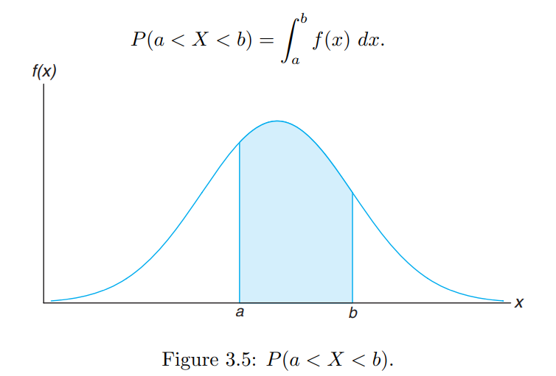
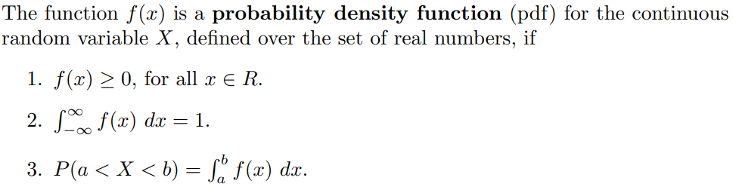
A probability density function is constructed so that the area under its curve bounded by the x axis is equal to 1 when computed over the range of X for which f(x) is defined. In Figure 3.5, the probability that X assumes a value between a and b is equal to the shaded area under the density function between the ordinates at x = a and x = b, and from integral calculus is given by

Slide 18
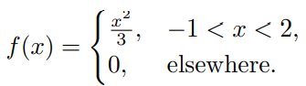
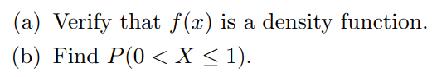
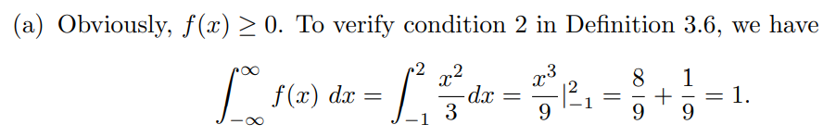
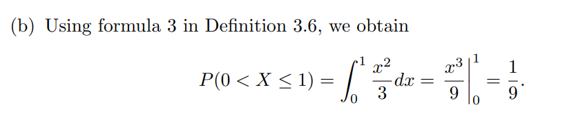
Suppose that the error in the reaction temperature, in ◦C, for a controlled laboratory experiment is a continuous random variable X having the probability density function

Slide 19
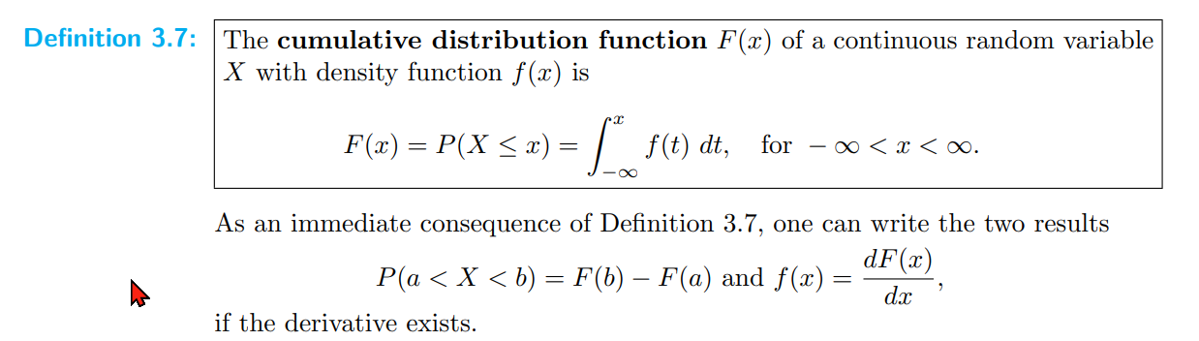
Cumulative distribution function

Slide 20
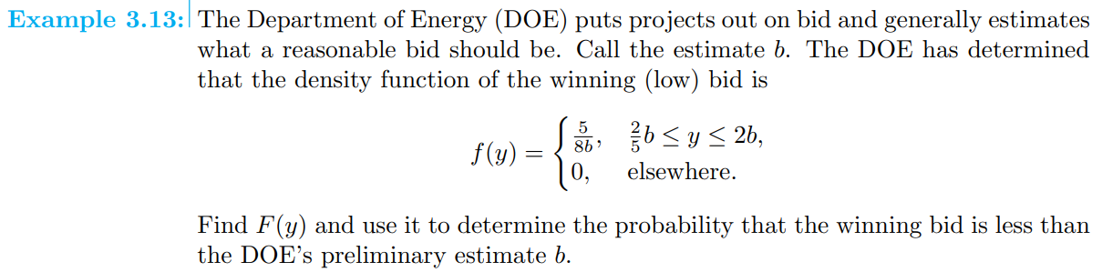

Slide 21


Slide 22
Assign probability
T ,F,V,G 🡪 .7/4=.175
R,Y,U,J,D,C,B🡪 .2/7=.0285
Other char 🡪 .1/15=.00667

Slide 23
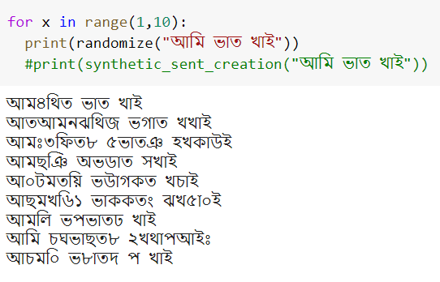

Slide 24
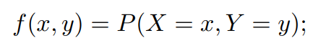
Joint probability distribution
One-dimensional sample spaces
Measure the amount of precipitate P and volume V of gas released from a controlled chemical experiment two-dimensional sample space consisting of the outcomes (p, v)
Hardness H and tensile strength T of cold-drawn copper, resulting in the outcomes (h, t).
If X and Y are two discrete random variables, the probability distribution for their simultaneous occurrence can be represented by a function with values f(x, y) for any pair of values (x, y) within the range of the random variables X and Y . It is customary to refer to this function as the joint probability distribution of X and Y .

Slide 25
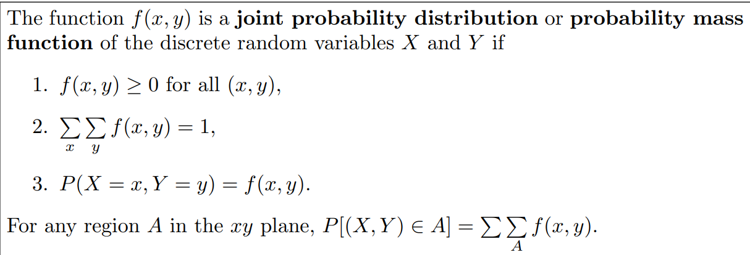
Joint probability distribution
The values f(x, y) give the probability that outcomes x and y occur at the same time.
For example, if an 18-wheeler is to have its tires serviced and X represents the number of miles these tires have been driven and Y represents the number of tires that need to be replaced, then f(30000, 5) is the probability that the tires are used over 30,000 miles and the truck needs 5 new tires.

Slide 26
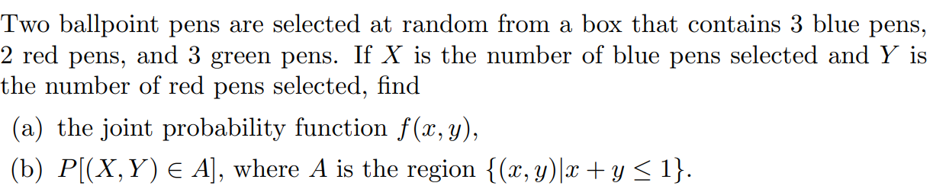
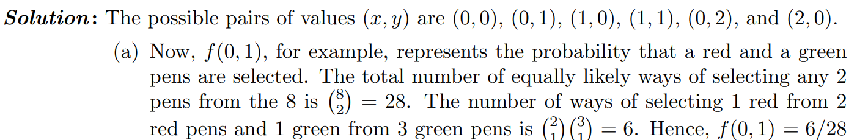
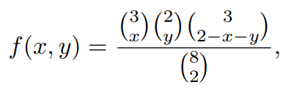

Slide 27
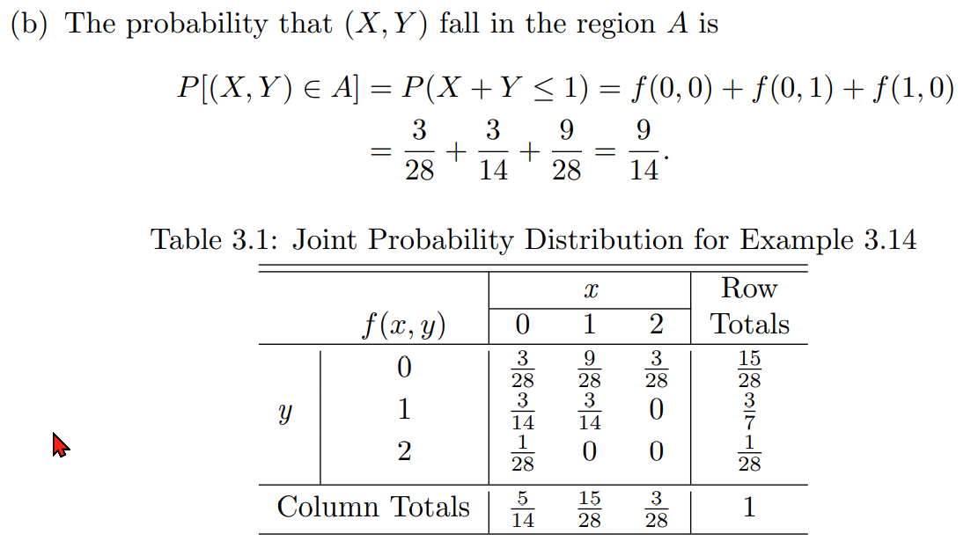

Slide 28
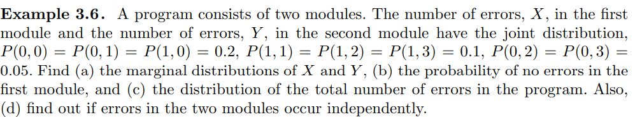
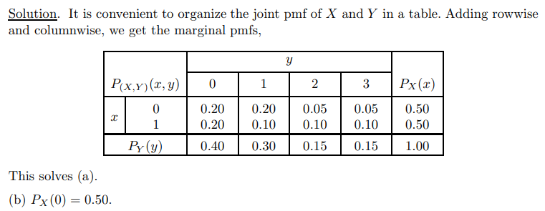
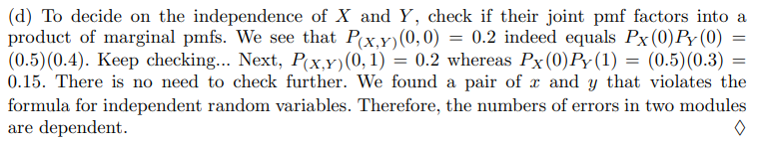
(c) 1

Slide 29
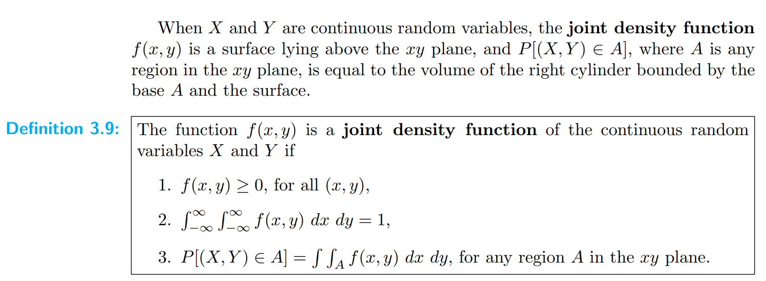
Joint density function

Slide 30
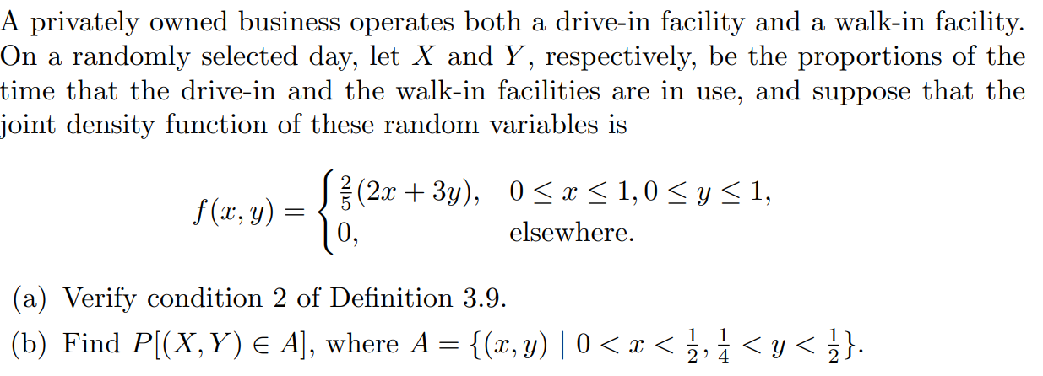
Example

Slide 31
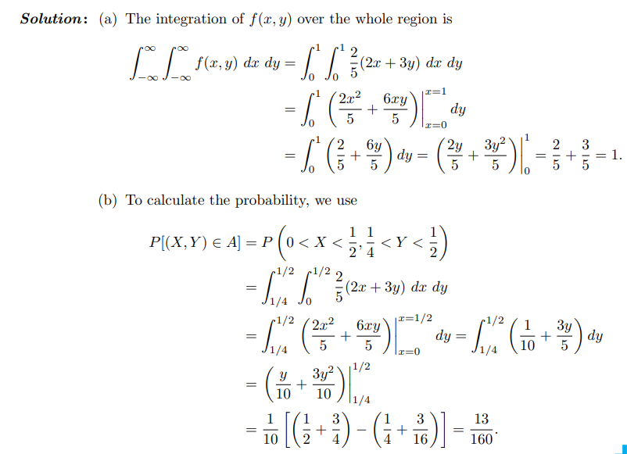

Slide 32
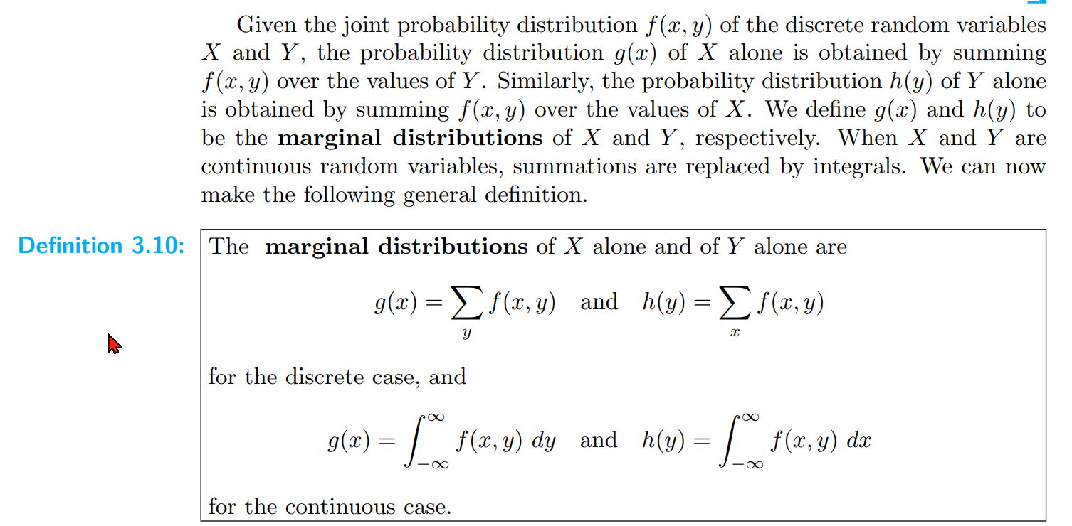

Slide 33
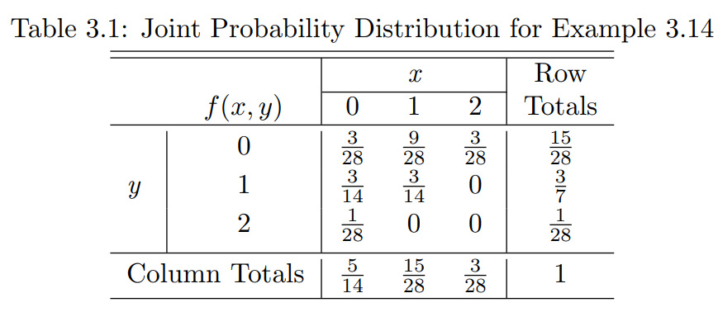
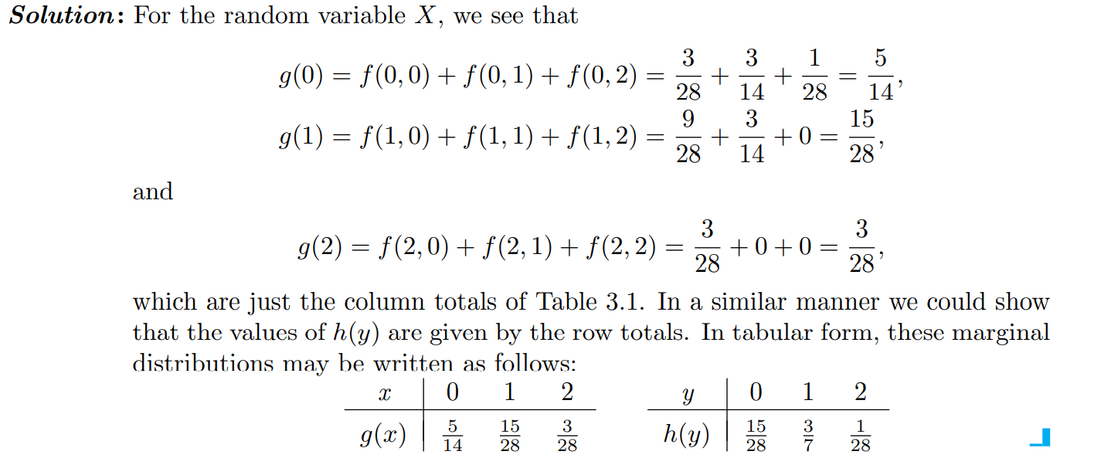

Slide 34
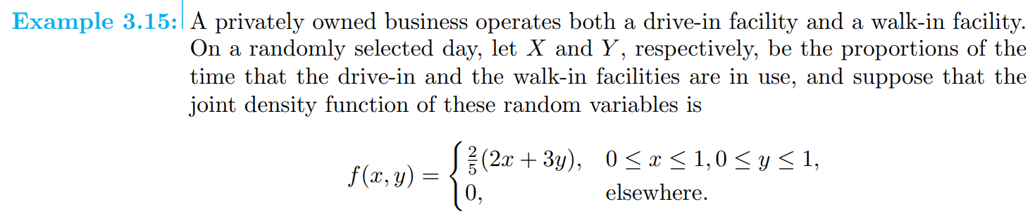
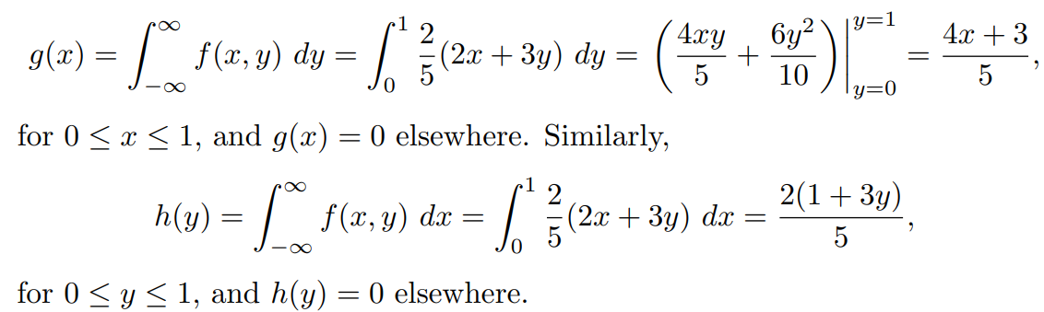

Slide 35
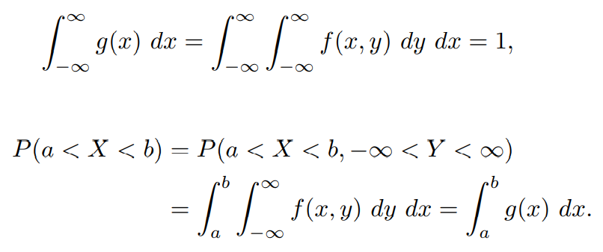
Fact

Slide 36
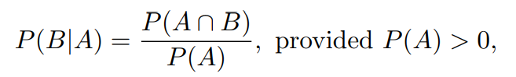
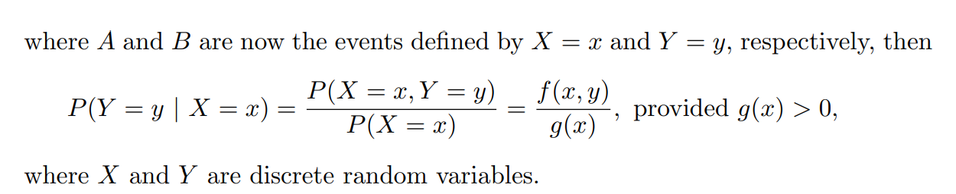
Conditional probability

Slide 37



Slide 38




Slide 39


Slide 40




Slide 41



Slide 42

Statistical Independence

Slide 43


Slide 44


Marginal distribution for multiple random variables
Let f(x₁, x₂,...,x_{n}) be the joint probability function of the random variables X₁, X₂,...,X_{n}. The marginal distribution of X₁, for example, is
for the continuous case.

Slide 45

We can now obtain joint marginal distributions such as g(x₁, x₂), where

Slide 46



